Slide 1

SWD 392 - Software Architecture and Design

Slide 2
Case Study
CHAPTER 22: Service-Oriented Architecture Case Study

Slide 3
Table of contents
01
Problem Description
05
Dynamic Modeling
02
Use Case Modeling
06
Broker and Wrapper Technology Support
03
Static Modeling
07
Design Modeling
04
Object and Class Structuring
08
Service Reuse

Slide 4

2.1 Problem description
The Online Shopping System
The Online Shopping System case study is a highly distributed World Wide Web–based system that provides services for purchasing items such as books or clothes.
The solution uses a service-oriented architecture with multiple services; coordinator objects are used to facilitate the integration of the services. In addition, object brokers are used to provide services which include:
a catalog service
an inventory service
a customer account service
a delivery order service
an email service
a credit card authorization service

Slide 5
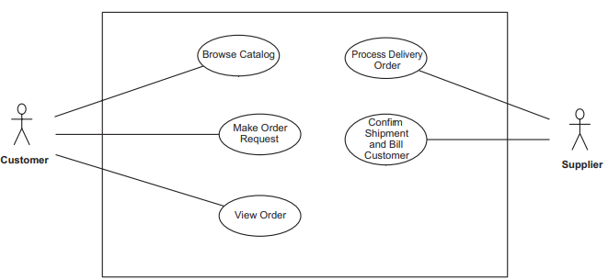
2.2 Use Case Model
Web-based Online Shopping System: use cases
Actors: Customer & Supplier
Customer, who browses a catalog and requests to purchase items
Supplier, who provides the catalog and services customer purchase requests

Slide 6
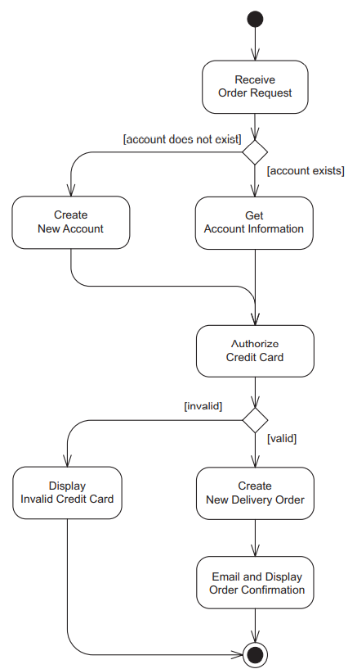
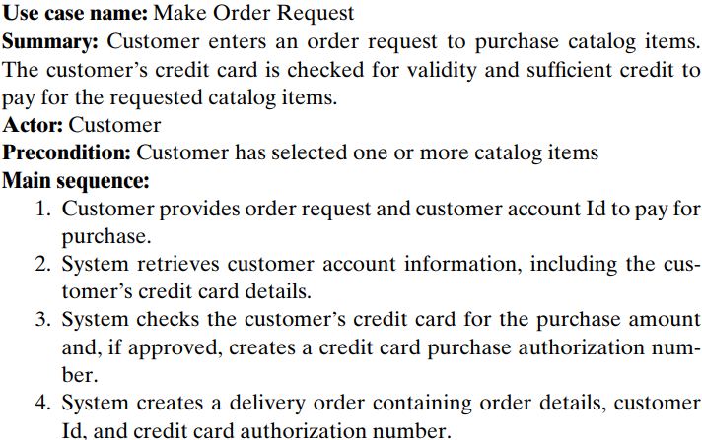
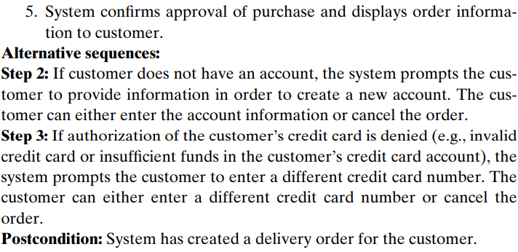
2.2 Use Case Model
Activity diagram for Make Order Request use case
Use Case Description for Make Order Request

Slide 7
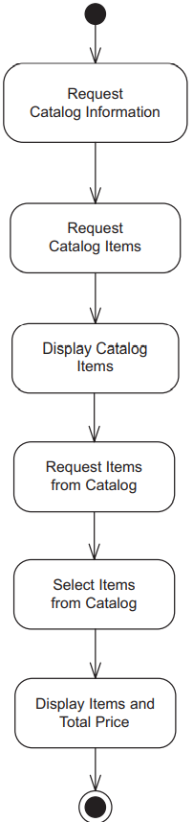
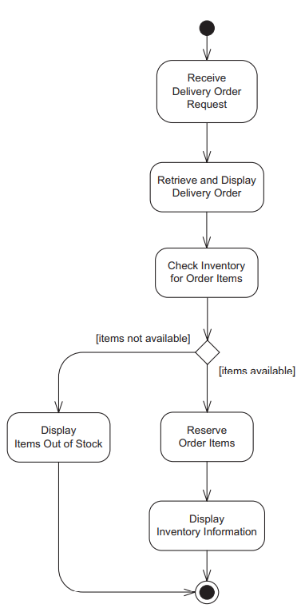
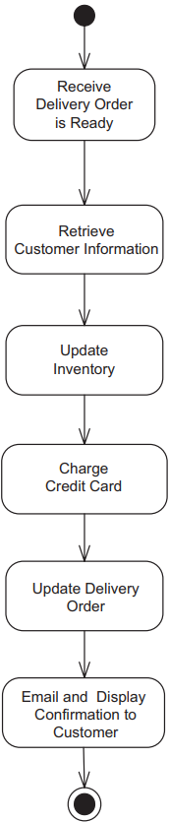
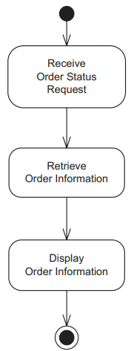
2.2 Use Case Model
Browse Catalog
Process Delivery Order
Confirm Shipment and Bill Customer
View Order

Slide 8
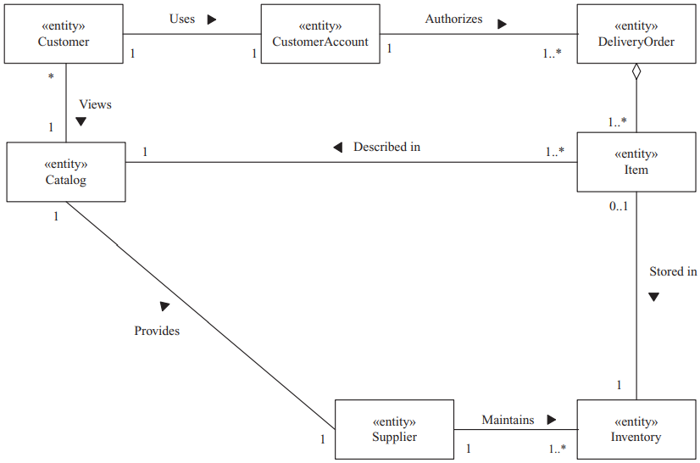
2.3 Static Modeling
Conceptual static model for Online Shopping System entity classes

Slide 9
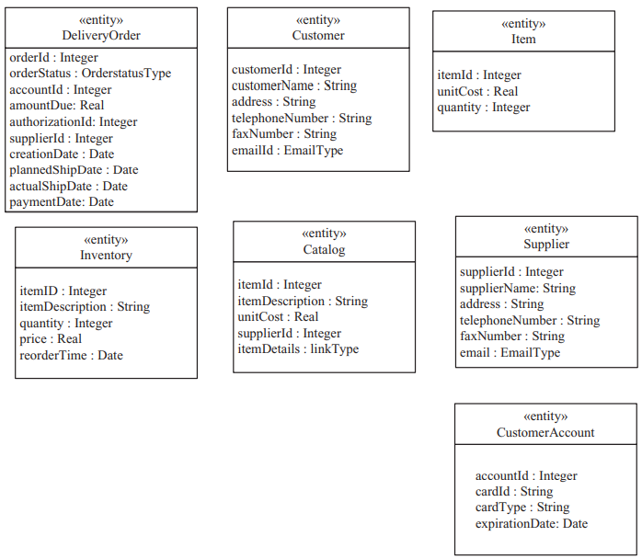
2.3 Static Modeling
A static model of the problem domain is developed and depicted on a class diagram.
Because this is a data-intensive application, the emphasis is on the entity classes.
The static entity class model shows the entity classes and the relationships among these classes.
The classes include customer classes (Customer and Customer Account), supplier classes (Supplier, Inventory, and Catalog), and classes that deal with the customer’s order such as Delivery Order, which is an aggregation of Item.
Entity classes for the Online Shopping System

Slide 10
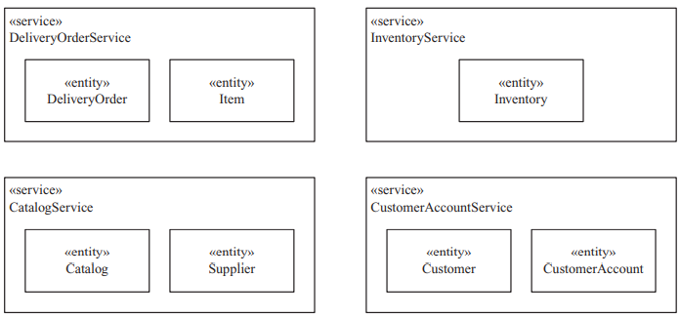
2.4 Object And Class Structuring
Catalog Service, Customer Account Service, Delivery Order Service, and Inventory Service are service classes that provide access to the entity classes.
Catalog Service uses the Catalog and Supplier entity classes.
Customer Account Service uses the Customer Account and Customer entity classes.
Delivery Order Service uses the Delivery Order and Item entity classes.
The Inventory Service uses the Inventory entity class.
Service and entity classes for the Online Shopping System

Slide 11
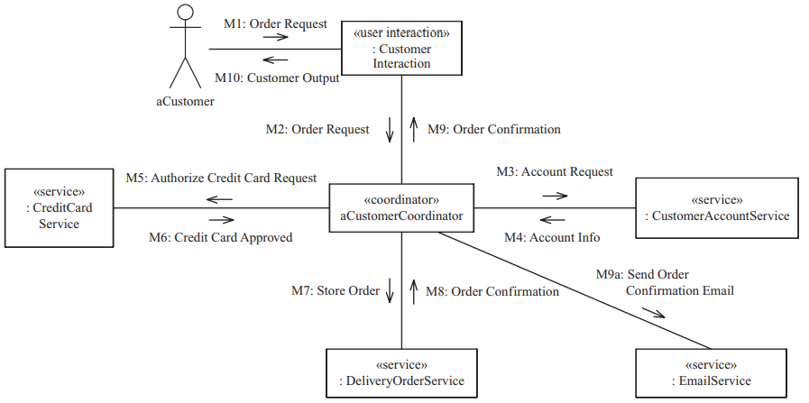
2.5 Dynamic Modeling
Communication diagram for the Make Order Request use case

Slide 12
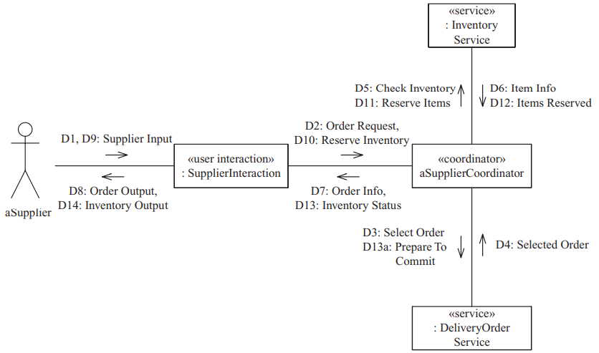
2.5 Dynamic Modeling
Communication diagram for the Process Delivery Order use case

Slide 13
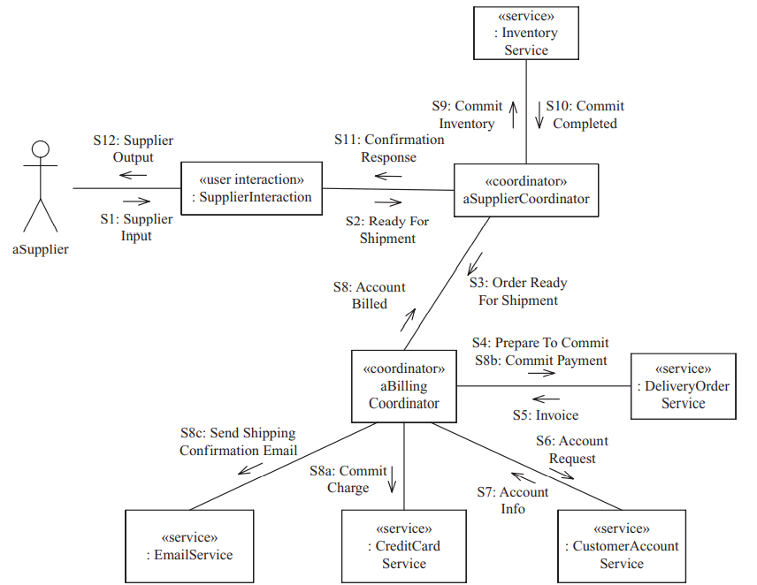
2.5 Dynamic Modeling
Communication diagram for the Confirm Shipment and Bill Customer use case

Slide 14
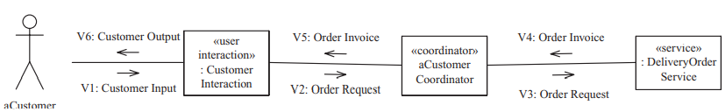
2.5 Dynamic Modeling
Communication diagram for the View Order use case

Slide 15

2.6 BROKER AND WRAPPER TECHNOLOGY SUPPORT
Several legacy databases are used in the Online Shopping System. Many of the entity classes in the static model represent persistent data stored in legacy databases.
Each legacy database is a stand-alone database that resides on a mainframe. These databases need to be integrated into the application, by means of a broker and wrapper technology.
Object broker and wrapper technology provide a systematic way of integrating the disparate legacy databases into a service-oriented architecture.
The legacy databases in the supplier organization are the catalog database, the inventory database, the customer account service, and the delivery order database.
Database wrapper classes are designed to provide an object-oriented interface to the legacy databases that hides the details of how to read and update the individual databases.

Slide 16
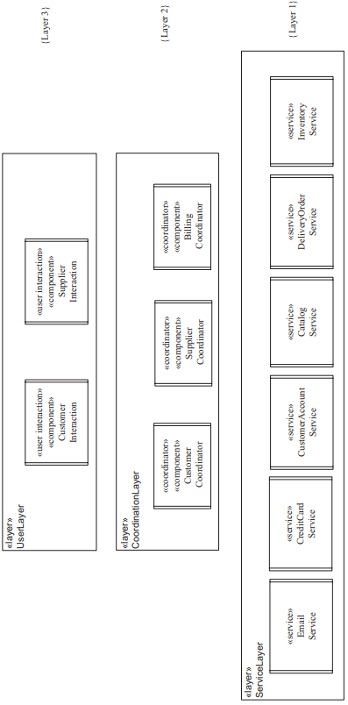
2.7 Design Modeling
The components are structured into the layered architecture such that each component is in a layer where it depends on components in the layers below but not the layers above. This layered architecture is based on the Layers of Abstraction pattern. Applying the component structuring criteria, the following components and services, organized by layer, are determined:
Layer 1: Service Layer. There are six services; four are part of the application, and two are external services.
Layer 2: Coordination Layer. There are three coordinator components: Supplier Coordinator, Customer Coordinator, and Billing Coordinator.
Layer 3: User Layer. There are two user interaction components: Supplier Interaction and Customer Interaction.
Layered architecture for Online Shopping System

Slide 17
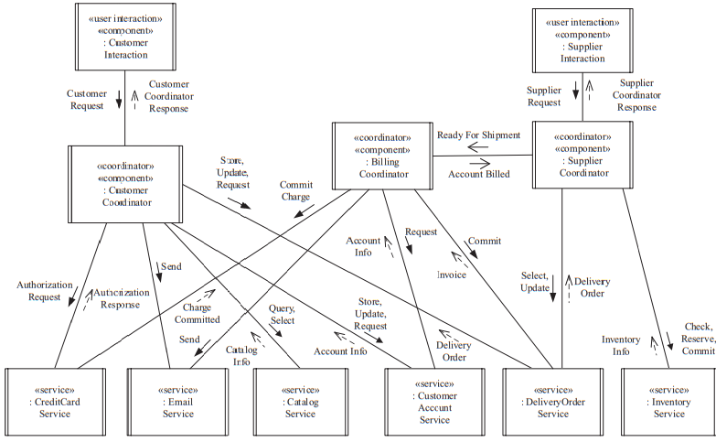
2.7 Design Modeling
Concurrent communication diagram for Online Shopping System

Slide 18
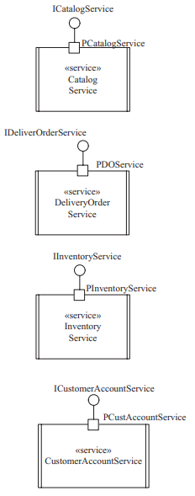
2.7 Design Modeling
Each service has one provided interface through which the service operations are accessed.
The clients of the service invoke the appropriate operations provided by the interface synchronously. The service operations are designed by considering how each individual service is accessed on the use case–based interaction diagrams. Typically, each service is accessed in different ways corresponding to requests for different service operations.
The interaction diagrams depict the messages arriving at the service (corresponding to service operation invocation and possible input parameters to the service) and the service response (corresponding to data returned by the service), which is either synchronous (as a synchronous message reply) or asynchronous (in a separate asynchronous message.
Component ports and interfaces for services

Slide 19
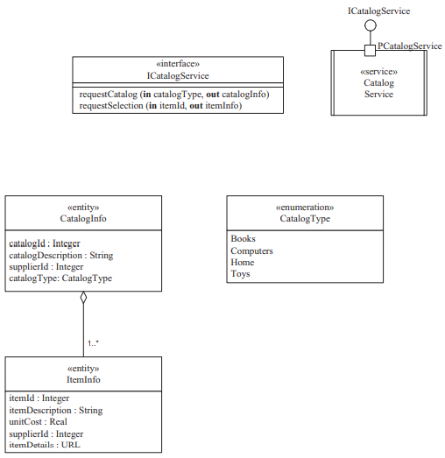
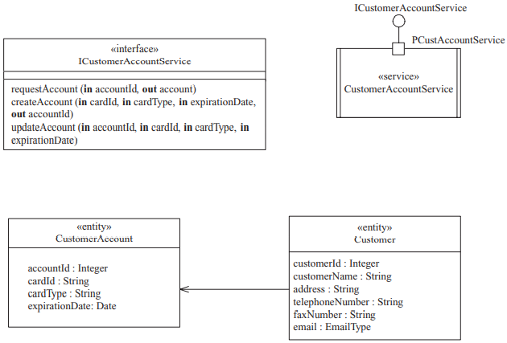
2.7 Design Modeling
Service interface for Catalog Service
Service interface for Customer Account Service

Slide 20
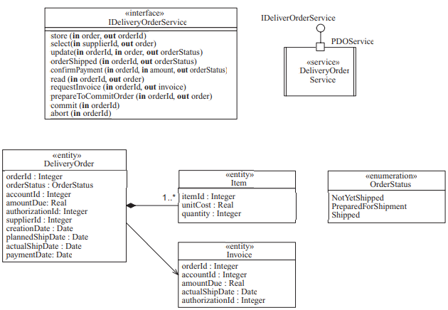
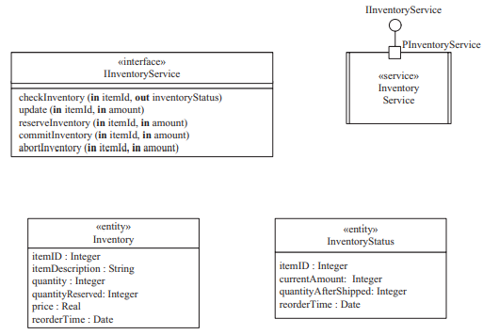
2.7 Design Modeling
Service interface for Delivery Order Service
Service interface for Inventory Service

Slide 21
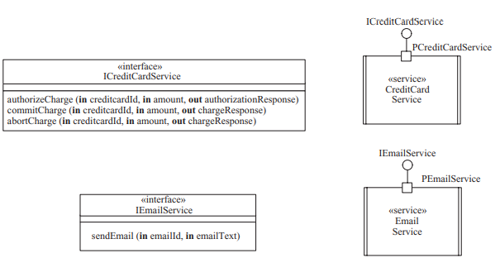
2.7 Design Modeling
Service interfaces for Credit Card and Email services

Slide 22
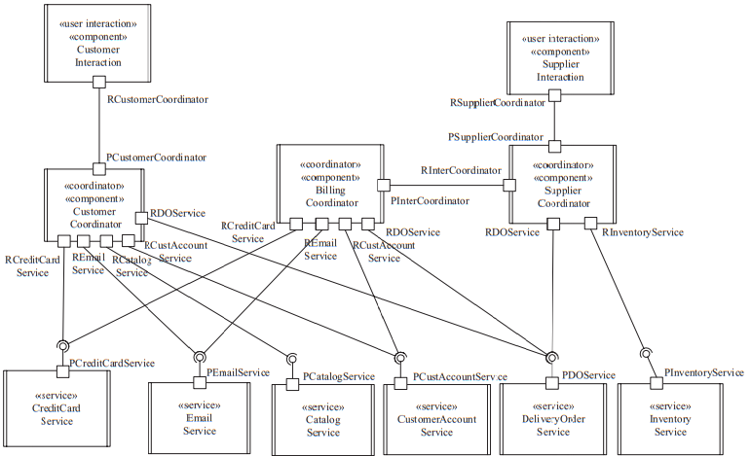
2.7 Design Modeling
Service-oriented software architecture for Online Shopping System

Slide 23

2.8 Service Reuse
Services can be composed into new applications. Other electronic commerce systems could be designed that would reuse the services provided by the Online Shopping System, such as Catalog Service, Delivery Order Service, and Inventory Service.
In a business to business (B2B) system, for example, instead of using customer accounts, contracts would be established between business customers and suppliers.
The B2B system would necessitate the creation of additional services as well as different versions of the Customer and Supplier Coordinators.
A reusable service-oriented architecture for an Electronic Commerce software product line, consisting of kernel, optional, and variant components and services.

Slide 24
Thank you for listening!

